Slide 1
Decision Structure and Boolean Logic Session 5
Course : COMP6056
Effective Period : September 2021

Slide 2
Sub Topics
Introduction to decision structure
Dual alternative decision structure
Compare string
Nested Decision
Case Structure
Logical Operators
Boolean variables

Slide 3
These slides have been adapted from: Gaddis, T. (2019). Starting Out with Programming Logic and Design 5^{th.} ISBN: 978-0-13-480115-5 Chapter 4
Acknowledgement

Slide 4
Learning Objectives
At the end of this lecture, students are able to:
LO1: To explain the uses of decision structure and Boolean logic
LO2: To write pseudo-code to solve problem containing decisions

Slide 5
Introduction to Decision Structures
A decision structure allows a program to perform actions only under certain conditions
Different types of decisions include
If, also called single alternative
If then else, also called dual alternative
Case structure for multiple alternative decisions
Gaddis, T., Starting Out With Programming Logic and Design, 5 ed, ISBN: 978-0-13-480115-5

Slide 6
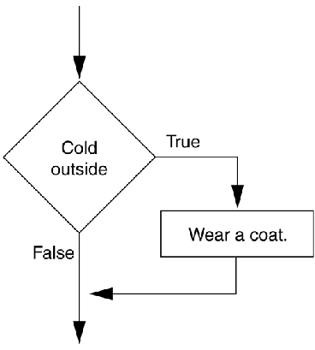
Introduction to Decision Structures
The if statement
An action only occurs if the decision is true
If condition Then
Statement
Statement
End If
A diamond symbol is used in flowcharts
Gaddis, T., Starting Out With Programming Logic and Design, 5 ed, ISBN: 978-0-13-480115-5

Slide 7
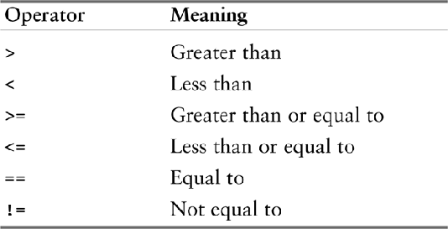
Introduction to Decision Structures
Relational Operators
Determines whether a specific relationship exists between two values
Used within the condition, a Boolean expression
x > y x<y x >=y x<y x <=y x==y x!=y
Relational operators
Gaddis, T., Starting Out With Programming Logic and Design, 5 ed, ISBN: 978-0-13-480115-5

Slide 8
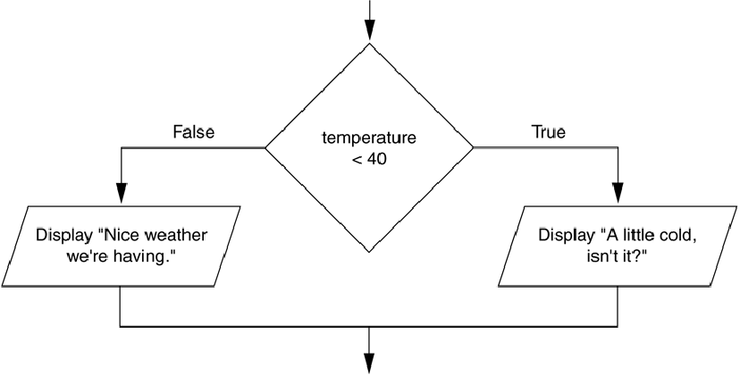
Dual Alternative Decision Structures
If then else statement
Executes one group of statements if it’s Boolean expression is true, or another group if its Boolean expression is false
A dual alternative decision structure
Gaddis, T., Starting Out With Programming Logic and Design, 5 ed, ISBN: 978-0-13-480115-5

Slide 9
Dual Alternative Decision Structures
If condition Then
statement
statement
Else
statement
statement
End if
If temperature < 40 Then
Display “A little cold”
Display “Get a coat!”
Else
Display “Nice weather”
Display “And sunny!”
End if
Gaddis, T., Starting Out With Programming Logic and Design, 5 ed, ISBN: 978-0-13-480115-5

Slide 10
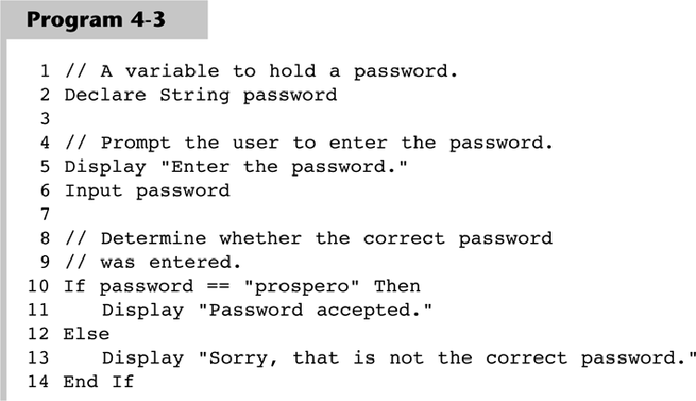
Comparing Strings
Gaddis, T., Starting Out With Programming Logic and Design, 5 ed, ISBN: 978-0-13-480115-5

Slide 11
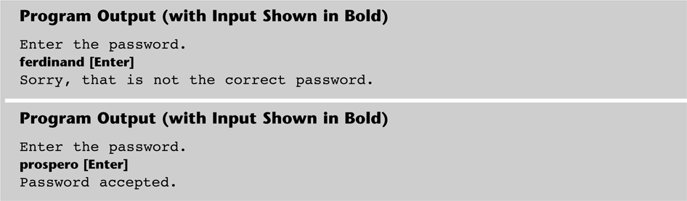
Comparing Strings
Gaddis, T., Starting Out With Programming Logic and Design, 5 ed, ISBN: 978-0-13-480115-5

Slide 12
Comparing Strings
Other String Concerns
String and strings can be compared
name1 == name 2
String and string literals can be compared
Month != “October”
String comparisons are generally case sensitive
You can also determine whether one string is greater than or less than another string (allows for sorting strings)
Gaddis, T., Starting Out With Programming Logic and Design, 5 ed, ISBN: 978-0-13-480115-5

Slide 13
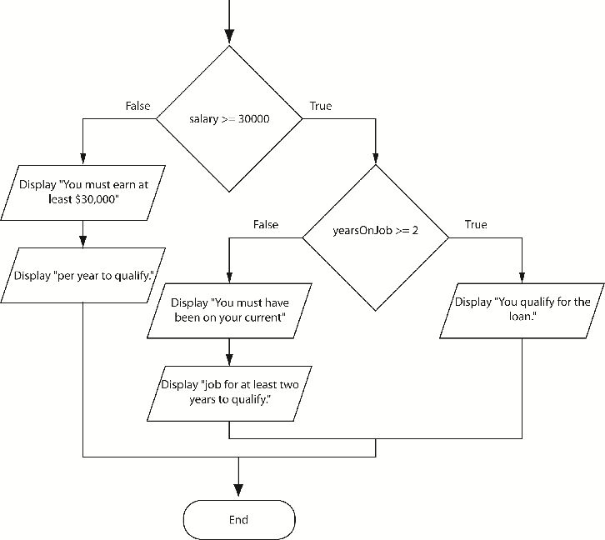
Nested Decision Structures
Decisions are nested in order to test more than one condition
If then if else example
Gaddis, T., Starting Out With Programming Logic and Design, 5 ed, ISBN: 978-0-13-480115-5

Slide 14
Nested Decision Structures
The if then else if statement can make nested logic simpler to write
If score < 60 Then
Display “Grade is F.”
Else If score < 70 Then
Display “Grade is D.”
Else If score < 80 Then
Display “Grade is C.”
Else If score < 90 Then
Display “Grade is B.”
Else
Display “Grade is A.”
End If
Gaddis, T., Starting Out With Programming Logic and Design, 5 ed, ISBN: 978-0-13-480115-5

Slide 15
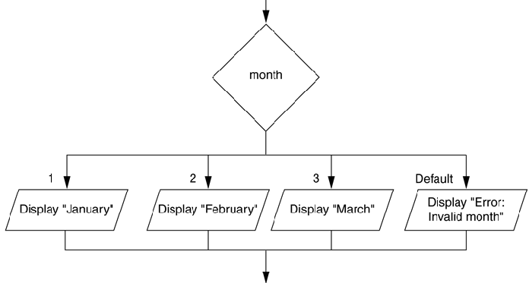
The Case Structure
The case structure lets the value of a variable or an expression determine which path of execution the program will take
Can be used as an alternative to nested decisions
Gaddis, T., Starting Out With Programming Logic and Design, 5 ed, ISBN: 978-0-13-480115-5

Slide 16
Logical Operators
Logical Operators are used between conditions to create complex Boolean expressions
AND – Both conditions must be true
OR – Either condition must be true
NOT – Reverses the truth of an expression
Gaddis, T., Starting Out With Programming Logic and Design, 5 ed, ISBN: 978-0-13-480115-5

Slide 17
Logical Operators
AND example
If temperature < 20 AND minutes > 12 Then
Display “The temperature is in the danger zone.”
End If
OR example
If temperature < 20 OR temperature > 100 Then
Display “The temperature is in the danger zone.”
End If
NOT example
If NOT (temperature > 100) Then
Display “This is below the maximum temperature.”
End If
Gaddis, T., Starting Out With Programming Logic and Design, 5 ed, ISBN: 978-0-13-480115-5

Slide 18
Logical Operators
Range Checking
Often used for range checking
When checking for a number inside a range, use AND
If x >=20 AND x <=40 Then
Display “The value is in the acceptable range.”
End If
When checking for a number outside a range, use OR
If x < 20 OR x >40 Then
Display “The value is outside the acceptable range.”
End If
Gaddis, T., Starting Out With Programming Logic and Design, 5 ed, ISBN: 978-0-13-480115-5

Slide 19
Boolean Variables
A variable of the Boolean data type can hold one or two values: true or false
Declare Boolean isLunchTime
If time >=12 then
Set isLunchTime = True
Else
Set isLunchTime = False
End If
Gaddis, T., Starting Out With Programming Logic and Design, 5 ed, ISBN: 978-0-13-480115-5

Slide 20
References
Gaddis, T. (2019). Starting Out with Programming Logic and Design 5th. ISBN: 978-0-13-480115-5

